Slide 1
Example FHIR Implementation Guide and Reference Implementation: Medical Formularies
Pacio project

Slide 2
Background
Developed as part of the Da Vinci project (Payer Data Exchange subgroup)
Focused on developing FHIR APIs for the Payer community
Based off of the Quality Health Program (QHP) work done by CMS back in 2015.
https://github.com/CMSgov/QHP-provider-formulary-APIs
Project Goals
Fulfill the requirements in the NPRM to provide information on plan provider networks, the plan's formulary, and coverage policies to patients
Develop and Implementation Guide, Reference Implementation (client and server), and associated automated testing
Publish these materials as examples for vendors and app developers to follow to ease their development and testing and to promote adoption of the NPRM and Implementation Guide.

Slide 3
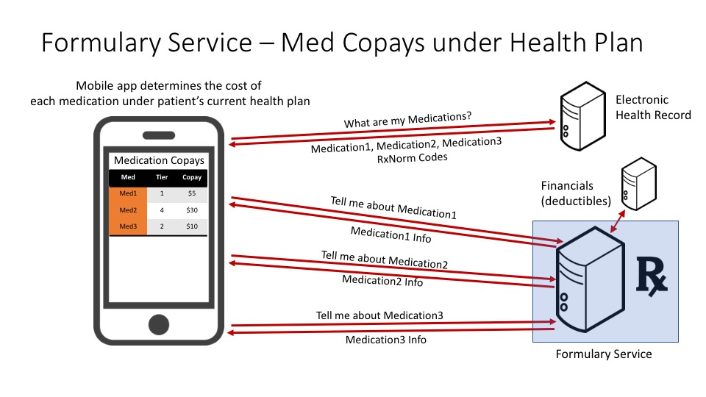
Use Cases

Slide 4
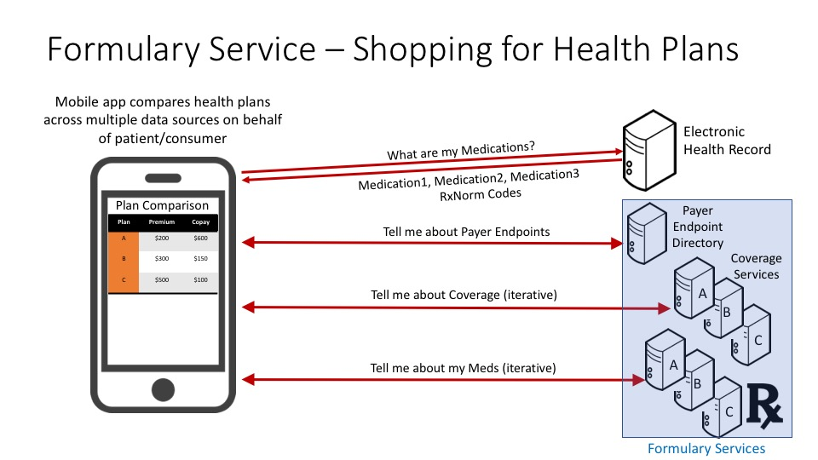
Use Cases

Slide 5
Project Deliverables
Deliverable | Information
Implementation Guide: | http://hl7.org/fhir/us/Davinci-drug-formulary/Jun2019/
Implementation Guide Repository: | https://github.com/HL7/davinci-pdex-formulary
Server Reference Implementation: | https://api-v8-r4.hspconsortium.org/DrugFormulary2/open/
Client Reference Implementation: | https://davinci-pdex-formulary-client.logicahealth.org
Client Reference Implementation Code Repository: | https://github.com/HL7-DaVinci/pdex-formulary-client

Slide 6
Automated Testing
Testing Tool | Validates | Information
AEGIS Touchstone | Server and Client | https://www.aegis.net/touchstone.html
ONC Inferno | Server | https://inferno.healthit.gov/inferno/

